Slide 1
ROM & PLA
Digital Logic And Computer Design
By M. Morris Mano (2nd Edition)
5.7, 5.8

Slide 2
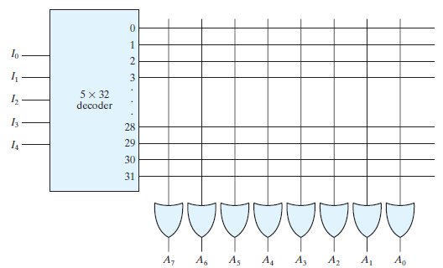
Read Only Memory (ROM)
2⁵ x 8 ROM
8 OUTPUTS
5 INPUTS
(Internal Circuit)
5 INPUTS
8 OUTPUTS

Slide 3
Read Only Memory (ROM)
How to store word for each input combination in ROM?
How to implement combinational circuit using ROM?
Answer: Define the connections between decoder outputs (minterms) and OR gates associated with output lines
The process is called Programming the ROM

Slide 4
Example
Program a 2² x 2 = 4 x 2 ROM according to the following truth table
Obtain the function output F₁ and F₂ in sum of minterms form
F₁ = ∑(1, 2, 3) F₂ = ∑(0, 2)
Input Combination |  | Word Combination (stored in ROM)
A₁ | A₀ | F₁ | F₂
0 | 0 | 0 | 1
0 | 1 | 1 | 0
1 | 0 | 1 | 1
1 | 1 | 1 | 0

Slide 5
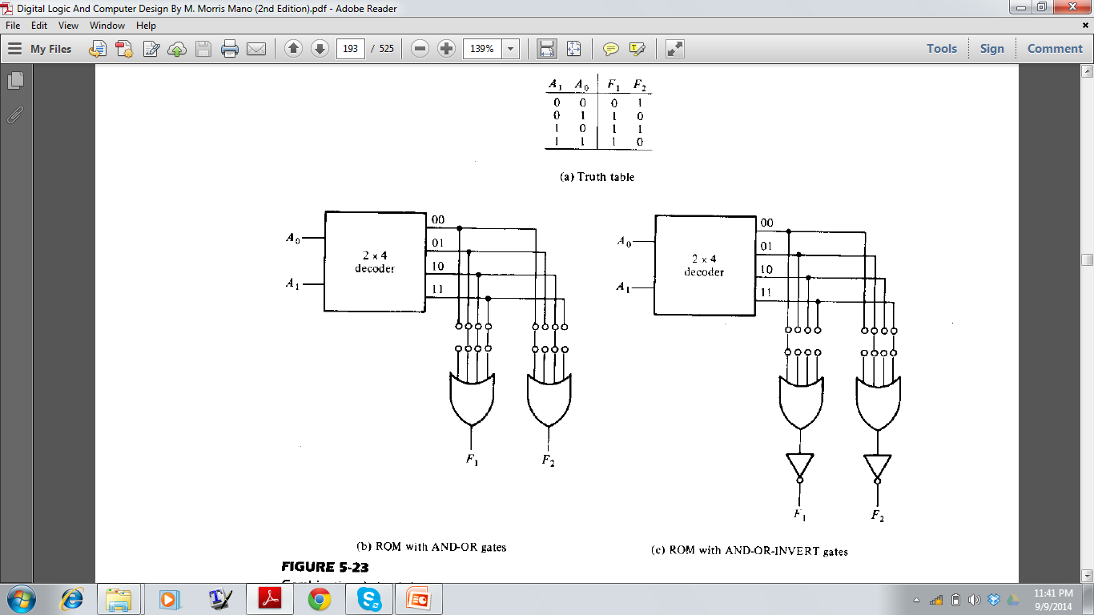
Combinational circuit with ROM
Initially all the minterms / output lines of the decoder are connected with the OR gates associated with the functions
For each OR gate,
keep the links for which the corresponding function outputs 1
Open / disconnect those links for which the corresponding function outputs 0
F₁ = ∑(1, 2, 3) F₂ = ∑(0, 2)

Slide 6
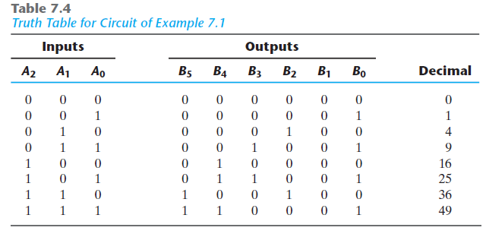
Design a combinational circuit using a ROM. The circuit accepts a three‐bit number and outputs a binary number equal to the square of the input number

Slide 7
Design a combinational circuit using a ROM. The circuit accepts a three‐bit number and outputs a binary number equal to the square of the input number
How many inputs and outputs for the ROM?

Slide 8
Design a combinational circuit using a ROM. The circuit accepts a three‐bit number and outputs a binary number equal to the square of the input number
Try to minimize the number of output lines for efficiency
Notes:
For each output line, we need an OR gate. So minimizing output lines will also minimize the number of OR gates.

Slide 9
Design a combinational circuit using a ROM. The circuit accepts a three‐bit number and outputs a binary number equal to the square of the input number
B₀ = A₀ !!!
Notes:
For each output line, we need an OR gate. So minimizing output lines will also minimize the number of OR gates.

Slide 10
Design a combinational circuit using a ROM. The circuit accepts a three‐bit number and outputs a binary number equal to the square of the input number
B₀ = A₀ !!!
B₁ = 0 !!!
Notes:
For each output line, we need an OR gate. So minimizing output lines will also minimize the number of OR gates.

Slide 11
Design a combinational circuit using a ROM. The circuit accepts a three‐bit number and outputs a binary number equal to the square of the input number
No need for these two output lines (avoid 2 OR gates)
Notes:
For each output line, we need an OR gate. So minimizing output lines will also minimize the number of OR gates.

Slide 12

Design a combinational circuit using a ROM. The circuit accepts a three‐bit number and outputs a binary number equal to the square of the input number
We Need 3 input, 4 output ROM :
2³ x 4 = 8 x 4 ROM
Notes:
For each output line, we need an OR gate. So minimizing output lines will also minimize the number of OR gates.

Slide 13
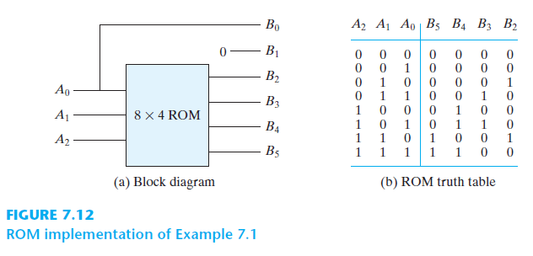
Design a combinational circuit using a ROM. The circuit accepts a three‐bit number and outputs a binary number equal to the square of the input number

Slide 14
PROGRAMMABLE LOGIC ARRAY
Useful for the case where don’t care conditions are excessive
Difference between ROM and PLA:
PLA does not generate all the minterms
In ROM, the functions need to be presented in sum of minterms form (F=XYZ+ZXY’+…), but in PLA, the functions should be simplified in sum of product terms (F=XY+Z+… ) (all literals need not be present in the product terms)
The decoder is replaced by a group of AND gates
Each AND gate represents a product term of the output functions

Slide 15
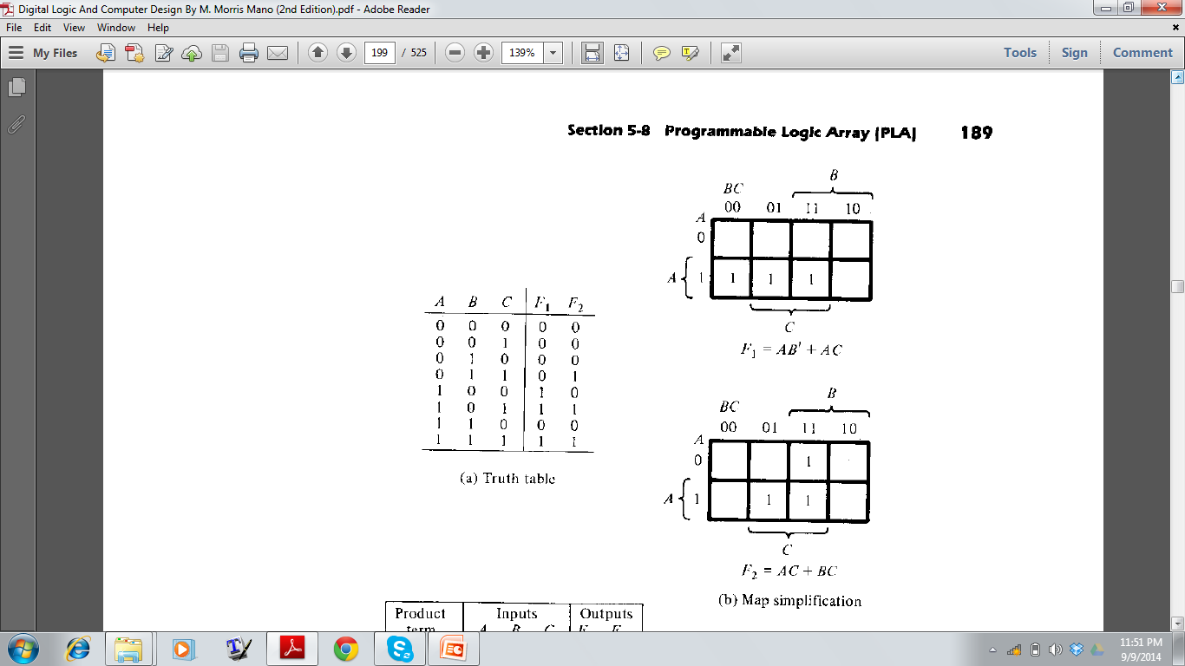
PROGRAMMABLE LOGIC ARRAY
Implement the following combinational circuit using PLA

Slide 16
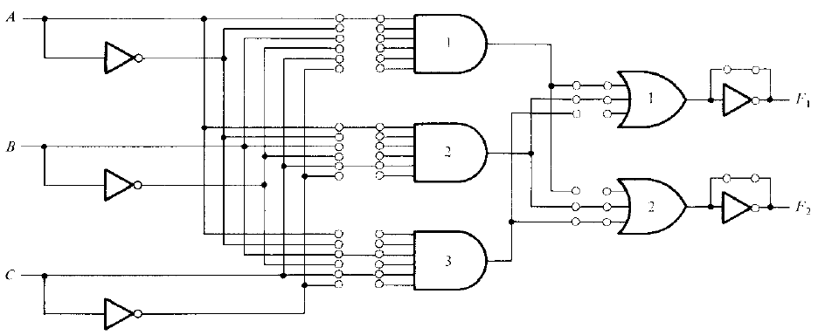
PROGRAMMABLE LOGIC ARRAY
Number of AND gates = Number of distinct product terms
For each AND gate, link from all the literals are available
For each OR gate, link from all the AND gates are available
F₁= AB’ + AC
F₂= AC + BC

Slide 17
PROGRAMMABLE LOGIC ARRAY
Programming the PLA:
For each AND gate,
Keep those links which are present as literal in the corresponding product term
Open / disconnect other links which are absent in the corresponidng product term
F₁= AB’ + AC
F₂= AC + BC

Slide 18
PROGRAMMABLE LOGIC ARRAY
Programming the PLA:
For each OR gate,
Keep those links which present the product terms in the corresponding function
Open / disconnect other links which are absent in the corresponding function
F₁= AB’ + AC
F₂= AC + BC

Slide 19
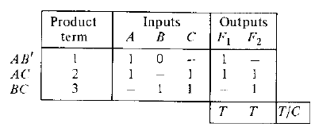
PROGRAMMABLE LOGIC ARRAY
Programming the PLA:
F₁= AB’ + AC
F₂= AC + BC

Slide 20
PROGRAMMABLE LOGIC ARRAY
How to increase efficiency?
Answer: Reduce the number of AND gates, that is, reduce the number of distinct product terms in the output functions
Find the simplified form for both the complemented and uncomplemented version of the functions
Consider the version which gives minimum number of distinct product terms

Slide 21
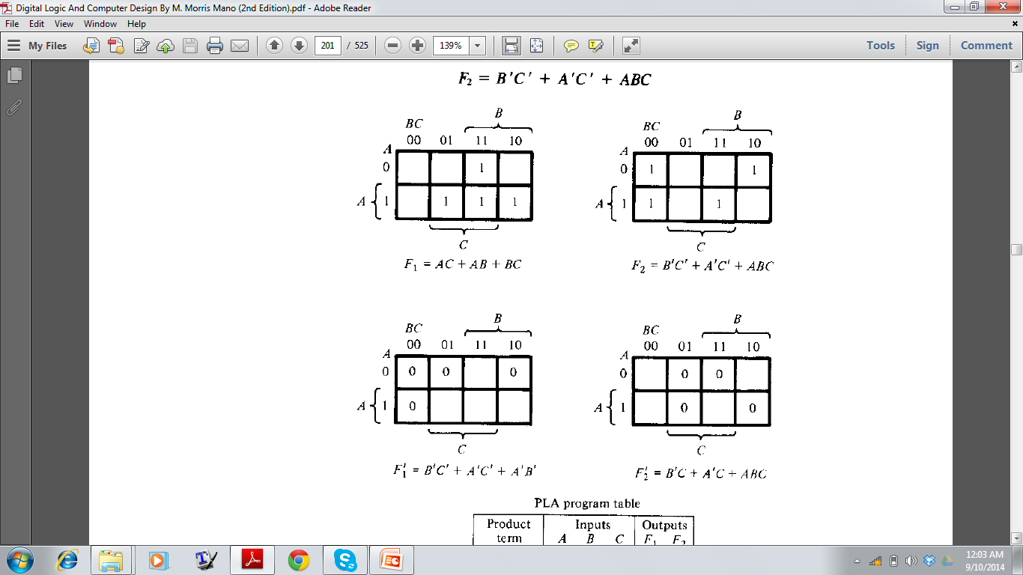
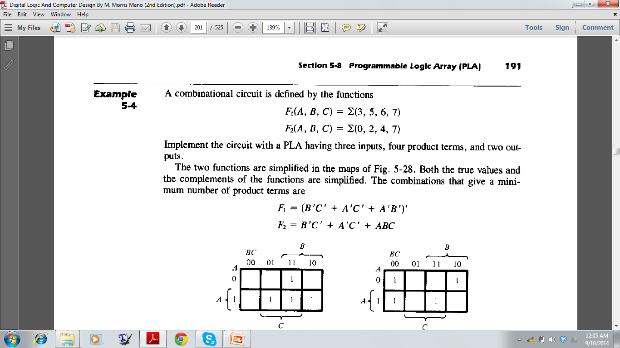
PROGRAMMABLE LOGIC ARRAY
Implement the circuit with PLA having 3 inputs, four product
terms. Two output.
F₁(A, B, C)= (3, 5, 6, 7)
F₂(A, B, C)= (0, 2, 4, 7)

Slide 22
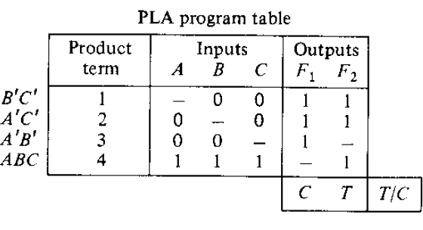
PROGRAMMABLE LOGIC ARRAY

